Slide 1
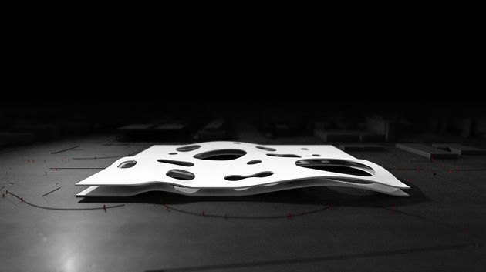
EPFL MOOCs
Lessons learned
Prof. Pierre Dillenbourg
Data from F. Pinto and P. Jermann
http://www.cgarchitect.com/
EPFL Center for Digital Education.
Rolex Learning Center

Slide 2
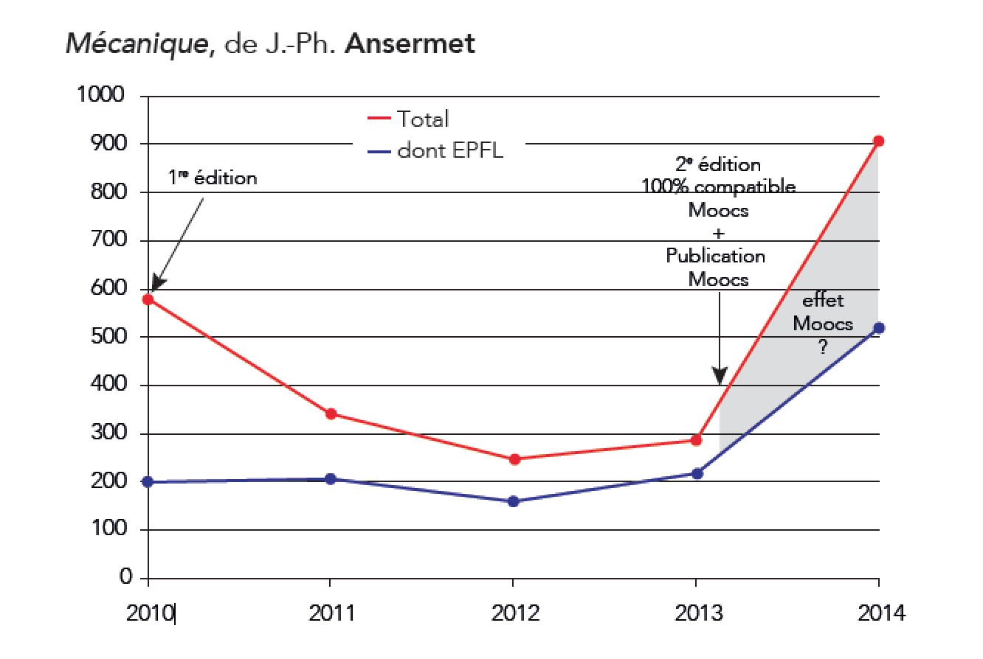



Slide 3


24 + 25 + 15

Slide 4
Why does EPFL produce MOOCs ?
Share knowledge outside campus
Increase EPFL visibility
Better pedagogy on campus
Support French speaking Africa
Boost Continous training
Generate revenues

Slide 5
WHY ?
World
Knowledge outside campus
EPFL visibility
Better pedagogy on campus
French speaking Africa
Continous training
Generating revenues
World
EPFL
World
Africa
EPFL
EPFL
USP
BA
Africa

Slide 6
Why does EPFL do MOOCs ?
Knowledge outside campus
EPFL visibility
Better pedagogy on campus
French speaking Africa
Continous training
Generating revenues

Slide 7
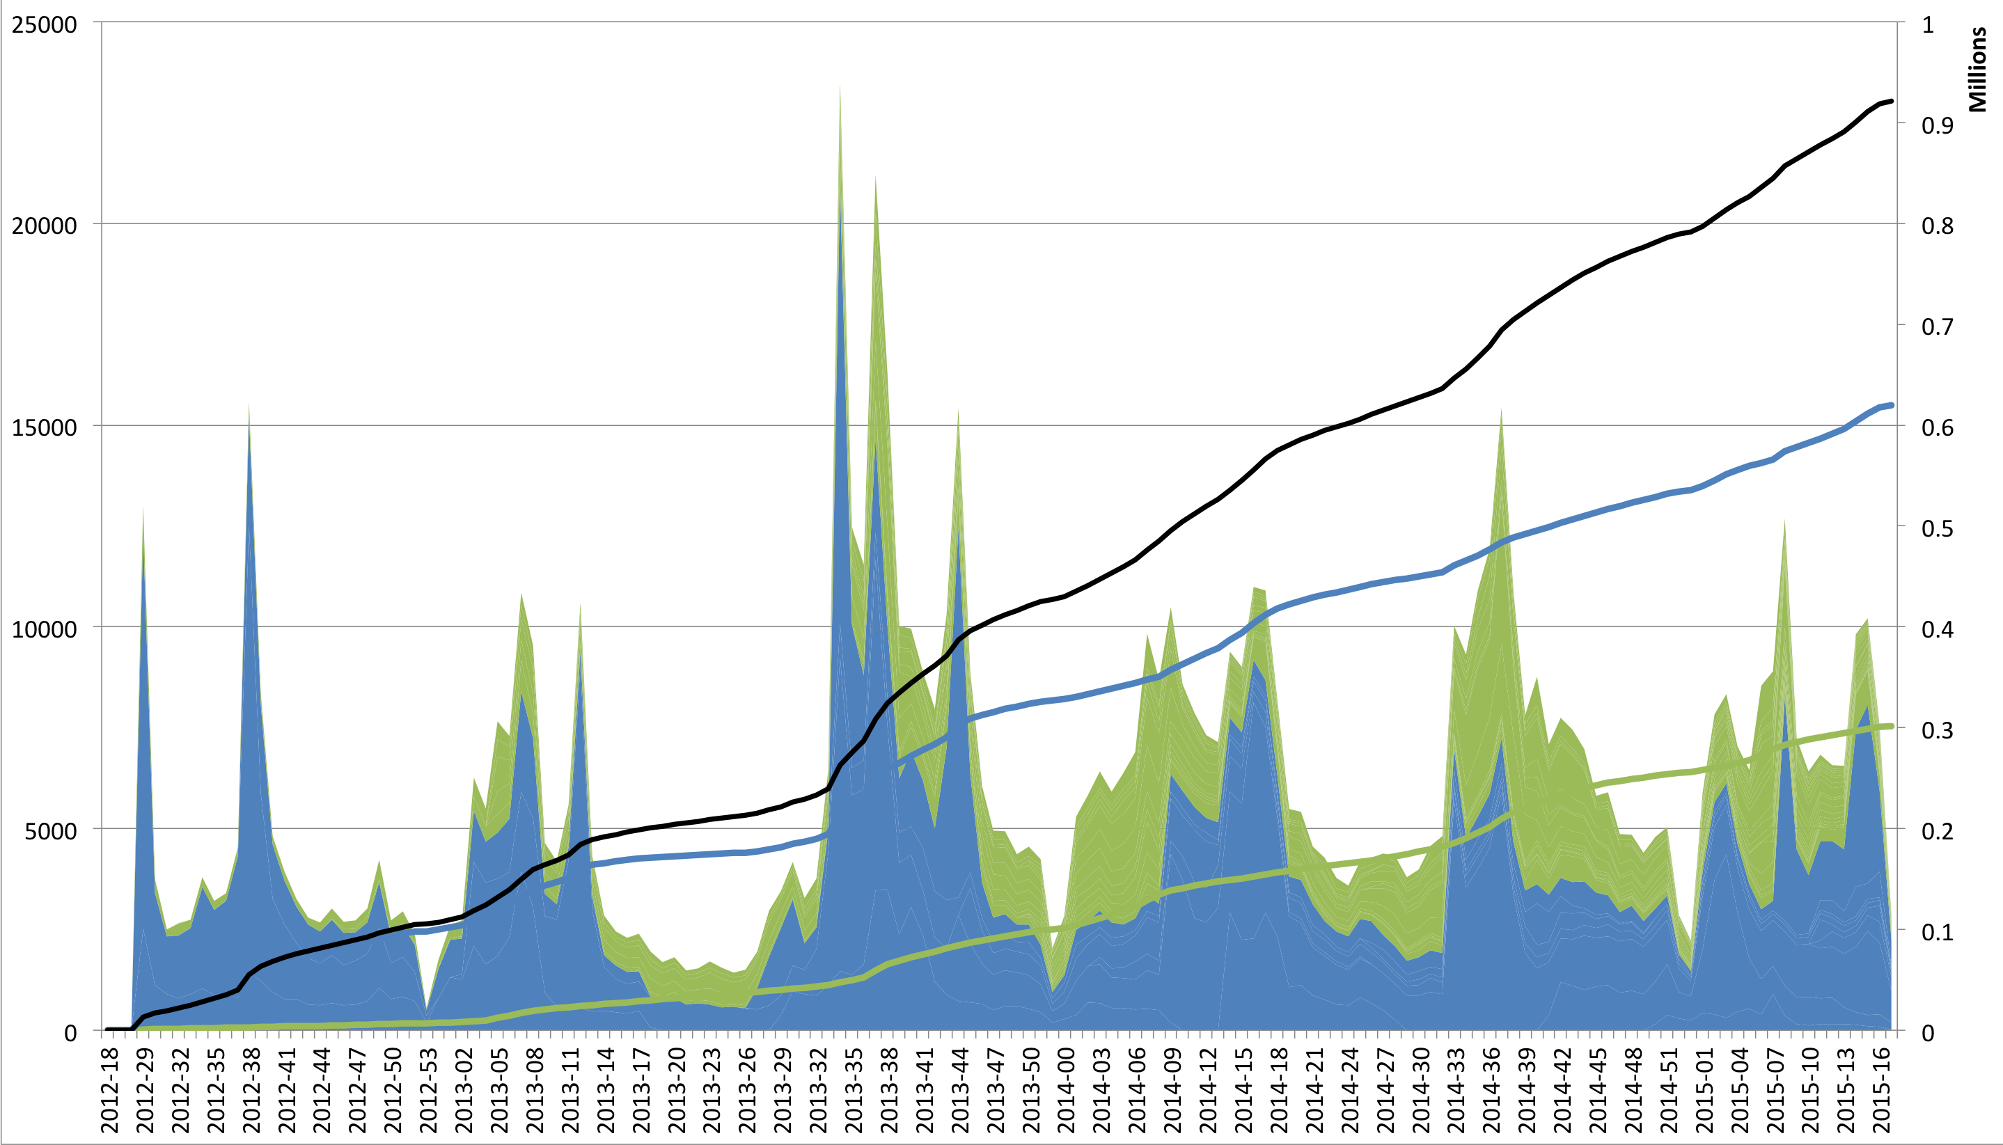
938,509

Slide 8
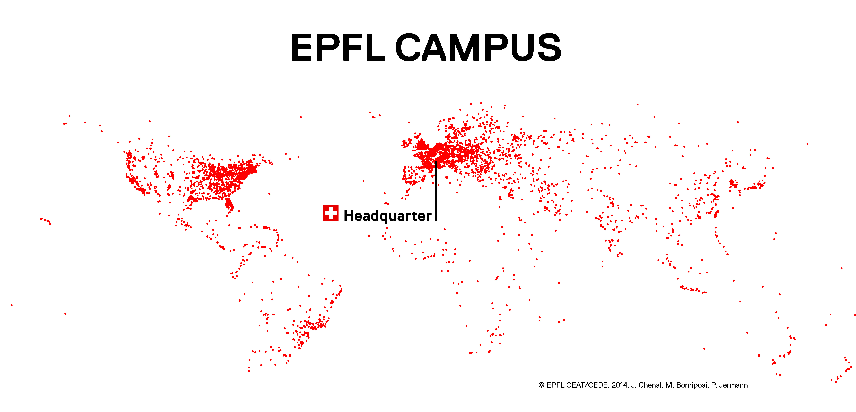
MOOCs are not the « McDonaldisation » of European universities

Slide 11
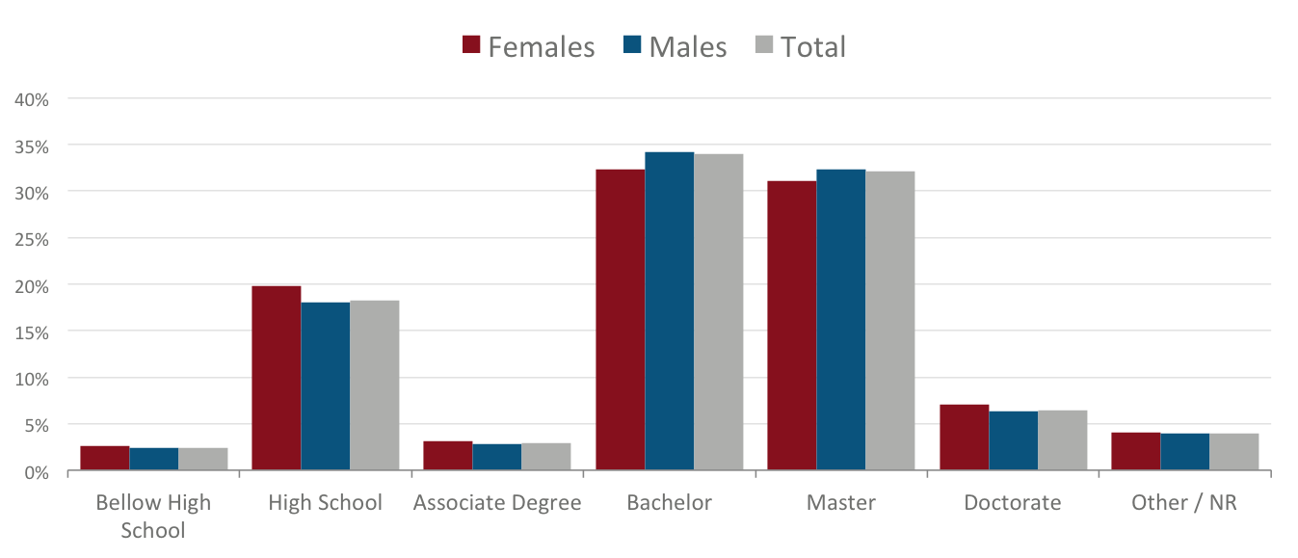

Slide 14
If our MOOCs are continuing education
And if we are lazy on continuing education
Then MOOCs solve a problem

Slide 15
Why does EPFL do MOOCs ?
✔ Knoweldge outside campus
✔ EPFL visibility
Better pedagogy on campus
French speaking Africa
✔ Continous training
Generating revenues

Slide 16
Why does EPFL do MOOCs ?
✔ Knoweldge outside campus
✔ EPFL visibility
? Better pedagogy on campus
French speaking Africa
✔ Continous training
Generating revenues

Slide 17
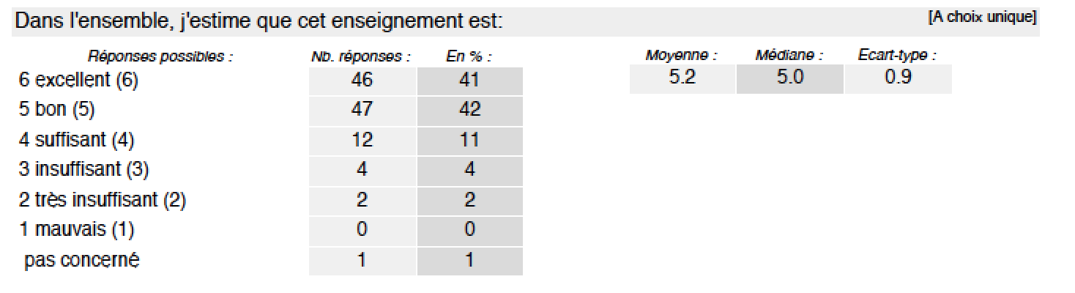
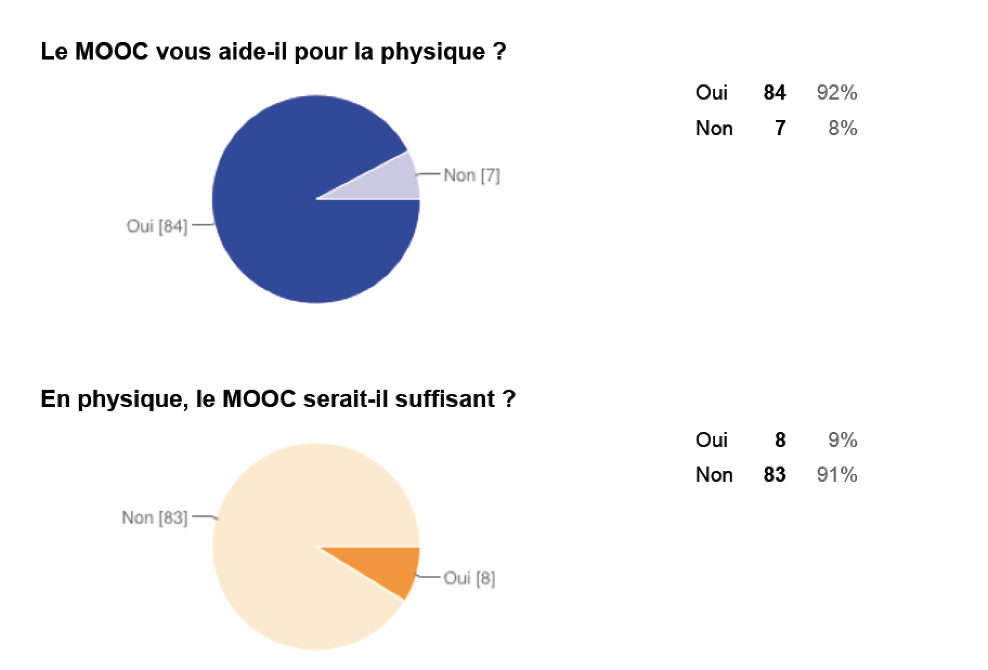
« Flipped Class »
Standard Lecture
Introduction à la programmation, J.-C. Chappelier
MOOC Physique Générale EPFL, J.-Ph. Ansermet

Slide 18
Pierre can you prove that MOOCs are courses in lectures rooms ?

Slide 19
Good MOOCs are (in general) better than bad MOOCS

Slide 20
What is a
« Good MOOC »
?

Slide 21
A MOOC with rich activities

Slide 22
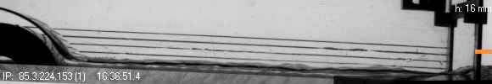
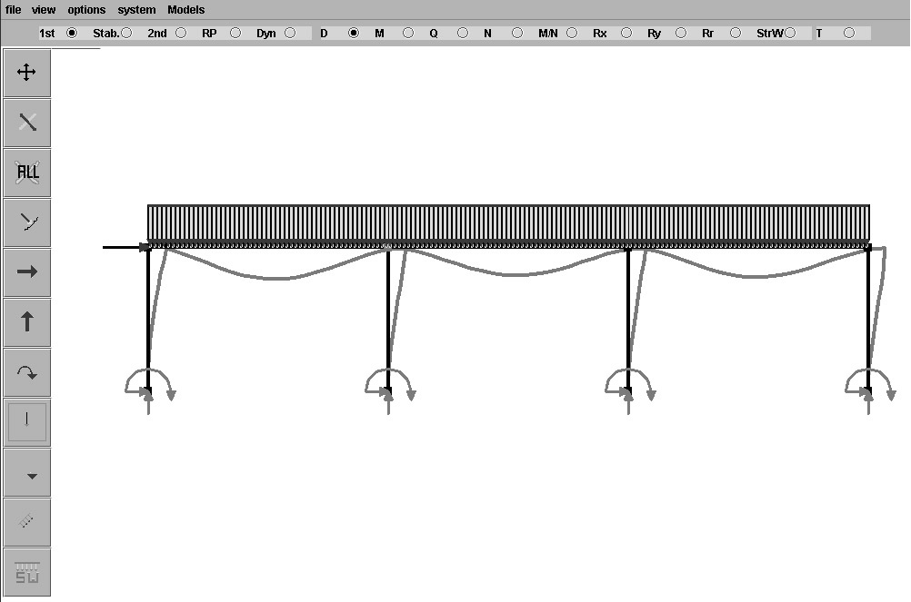
Fluid Dynamics (Gallaire & Ancey)
http://128.178.27.98:8082/LHE1.html
Statics (Muttoni & Burdet)

Slide 24
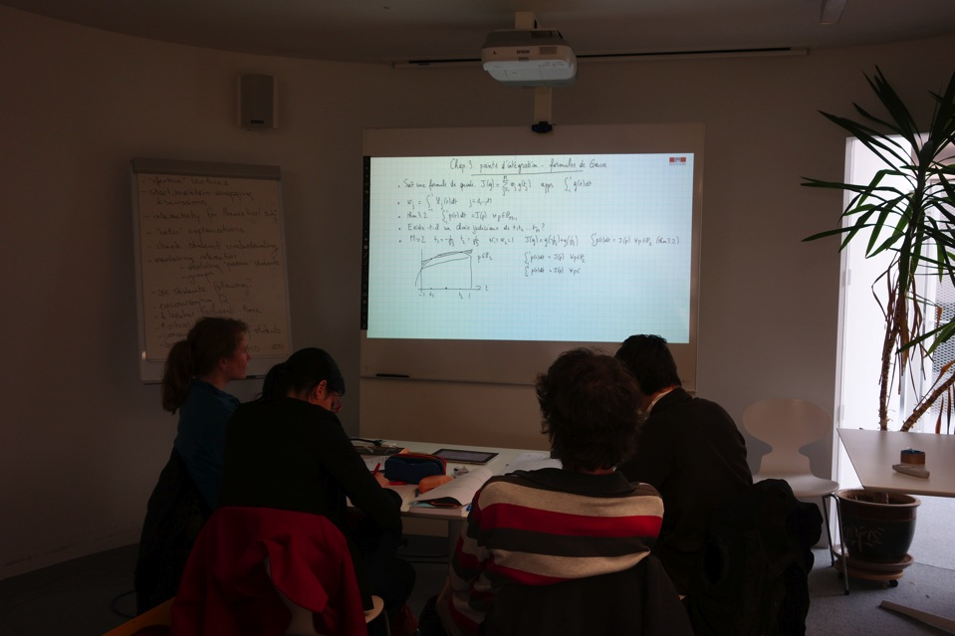
Watching MOOCs together
Notes:
We proposed students to watch MOOCs together. We tried different technologies and configurations, but, whatever set uo we used, they love watching MOOC together
MOOCs are difficult and there is ‘social facilitation’ effect: it ‘easier to suffer if we feel others suffer as well (that’s why all these stupid people run the marathon on the same day)
In a lecture room, you can say »Professor, could you stop 2 minutes while I explain what you said to my friend ; here we simply pause ».

Slide 25
MOOCs are very social

Slide 26
Why does EPFL do MOOCs ?
✔ Knoweldge outside campus
✔ EPFL visibility
? Better pedagogy on campus
French speaking Africa
✔ Continous training
Generating revenues
Teaching became a hight stake activity

Slide 27
Teachers spend more time preparing their course

Slide 28
Is it better to have a paper in nature or a MOOC with 50’000 participants ?

Slide 29
Why does EPFL do MOOCs ?
✔ Knoweldge outside campus
✔ EPFL visibility
? Better pedagogy on campus
✔ French speaking Africa
✔ Continous training
Generating revenues

Slide 30
MOOCs in Africa ?

Slide 31
Language Matters

Slide 33
!!! Raw numbers are low

Slide 34
Research

Slide 35
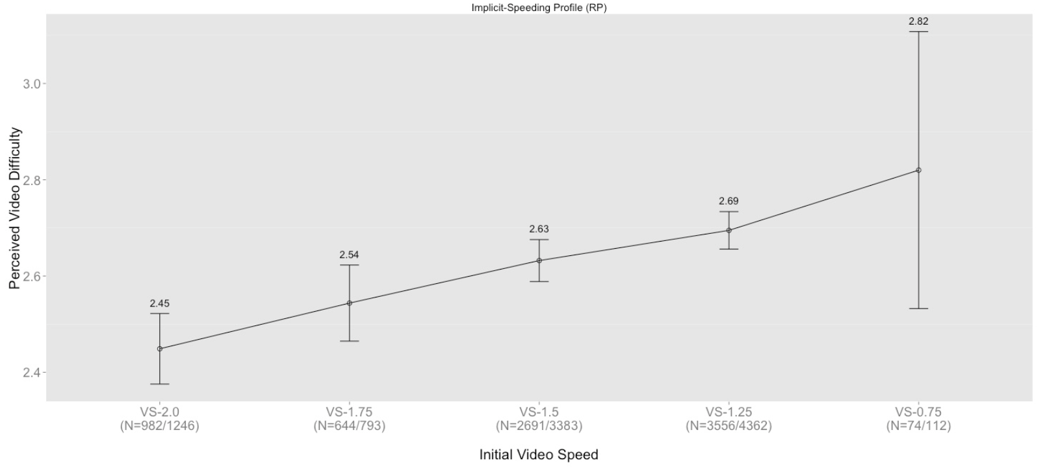
^{Nan Li, Lukasz Kidzinski;} ^{175,621 video sessions}
An increase of 0.25 video speed results in an average decrease of perceived difficulty by 16%
(p < .0001)

Slide 36
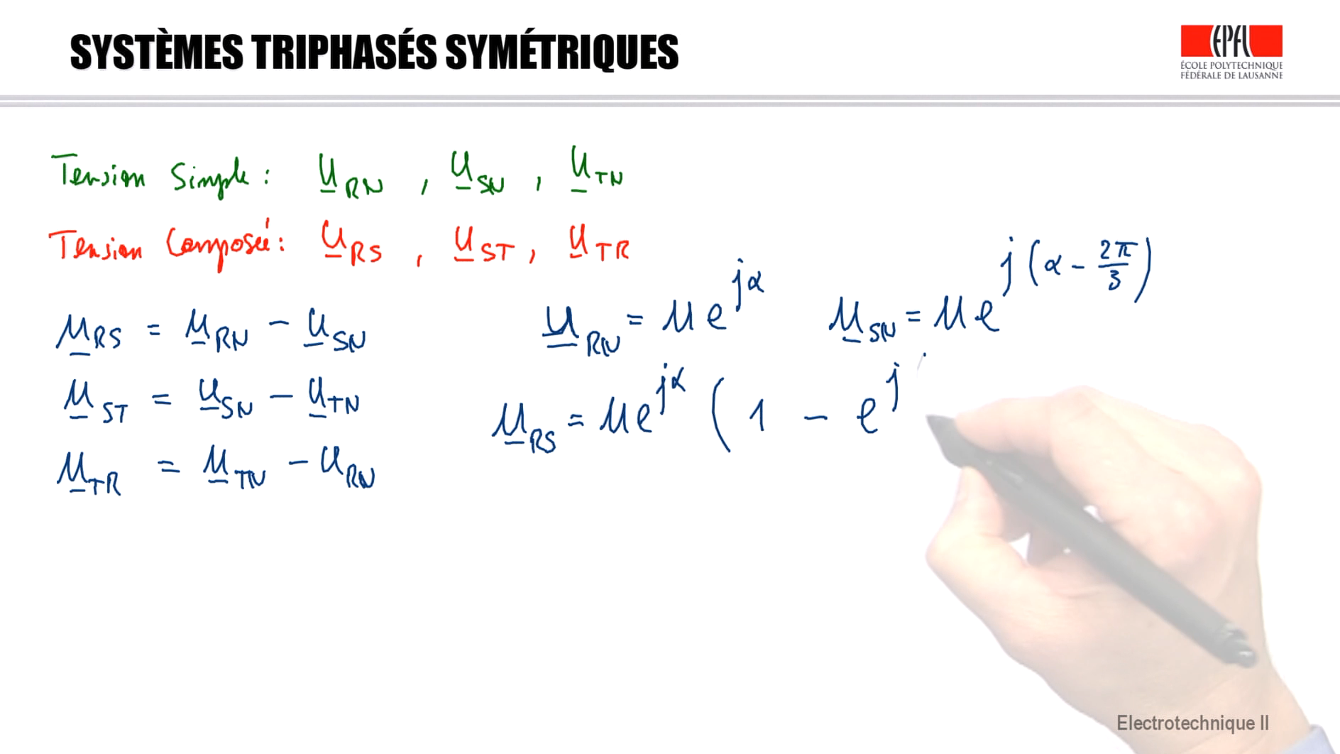
Is this hand useful ?
Kshitij Sharma, Patrick Jermann, Pierre Dillenbourg
EPFL Center for Digital Education

Slide 37
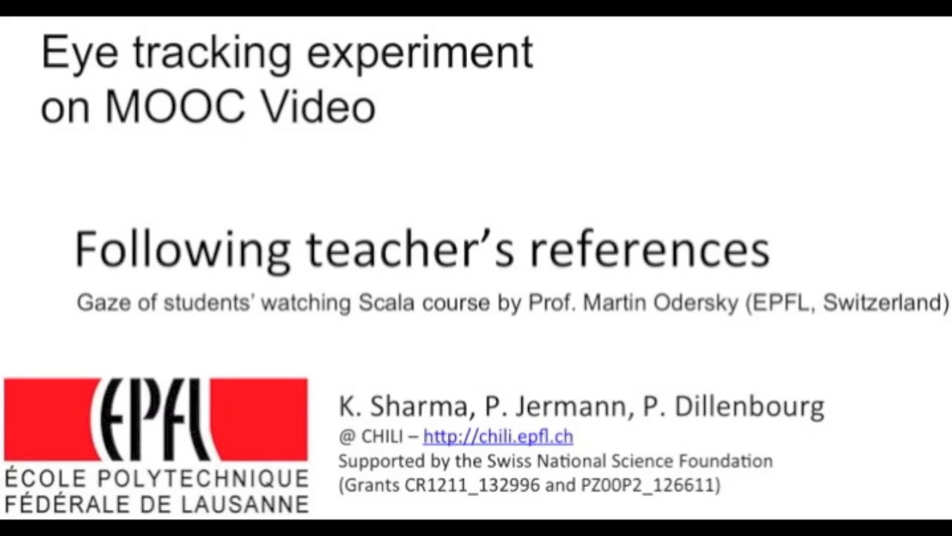

Slide 38
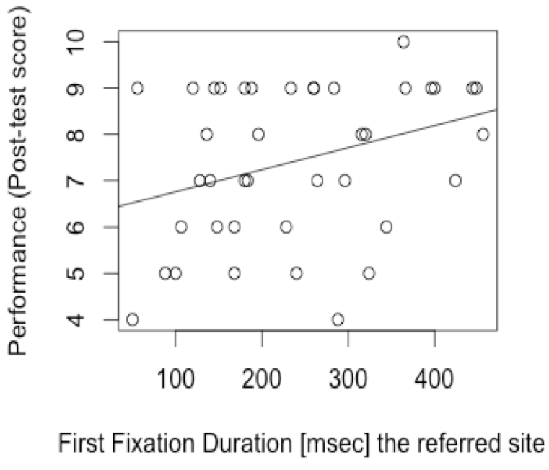
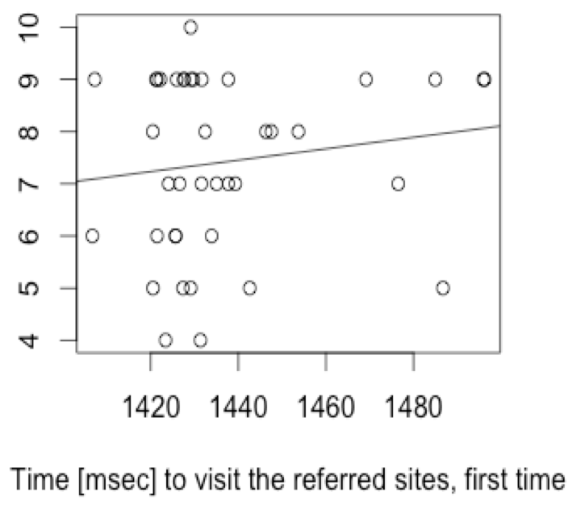
« withmeness »
0.1
0.35
Kshitij Sharma, Patrick Jermann, Pierre Dillenbourg
EPFL Center for Digital Education

Slide 40
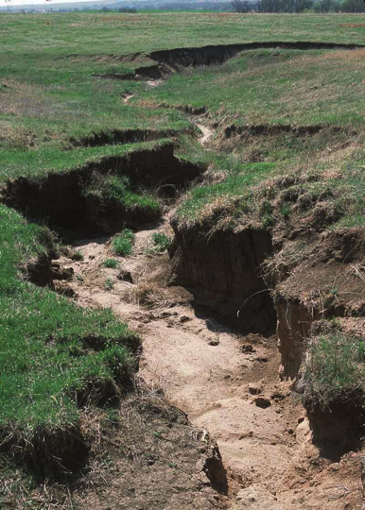
Please upload 3 pictures of soil erosion

Slide 41
20’000 X 3 / 0.5 = 30’000 pictures

Slide 42
30’000 pictures
Is it geological erosion or accelerated erosion ?
Is it geological erosion or accelerated erosion ?
Which one illustrates the best erosion?

Slide 43
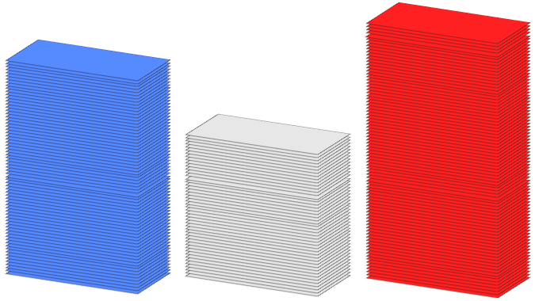
12’000
10’000
8’000
Geological erosion
Accelerated erosion

Slide 44
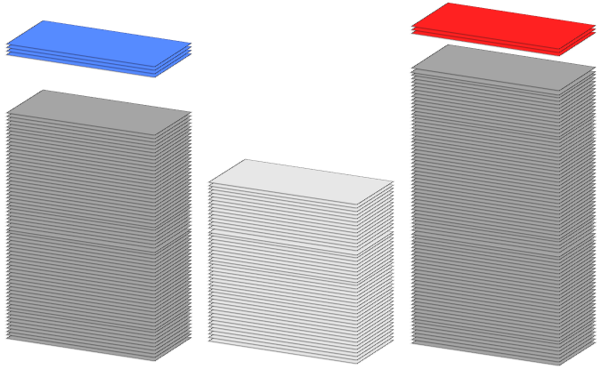
Select top 5% pictures
600
500
Geological erosion
Accelerated erosion

Slide 45
Orchestration Graphs

Slide 47
And….
Students spent 4-5 h/week
No ECTS credits so far
Series 3 MOOCS + capstone
Interest for corporate training
Interest from vocational education

Slide 48
Why is instructional psychology absent ?
« MOOCs are lower quality than standards in instructional design, hence learning scientists
should not work on MOOCs »

Slide 49
Better be an actor
than a spectator
Beware of the Kodak syndrome
Pierre Dillenbourg, Center for Digital Education, EPFL

Slide 51
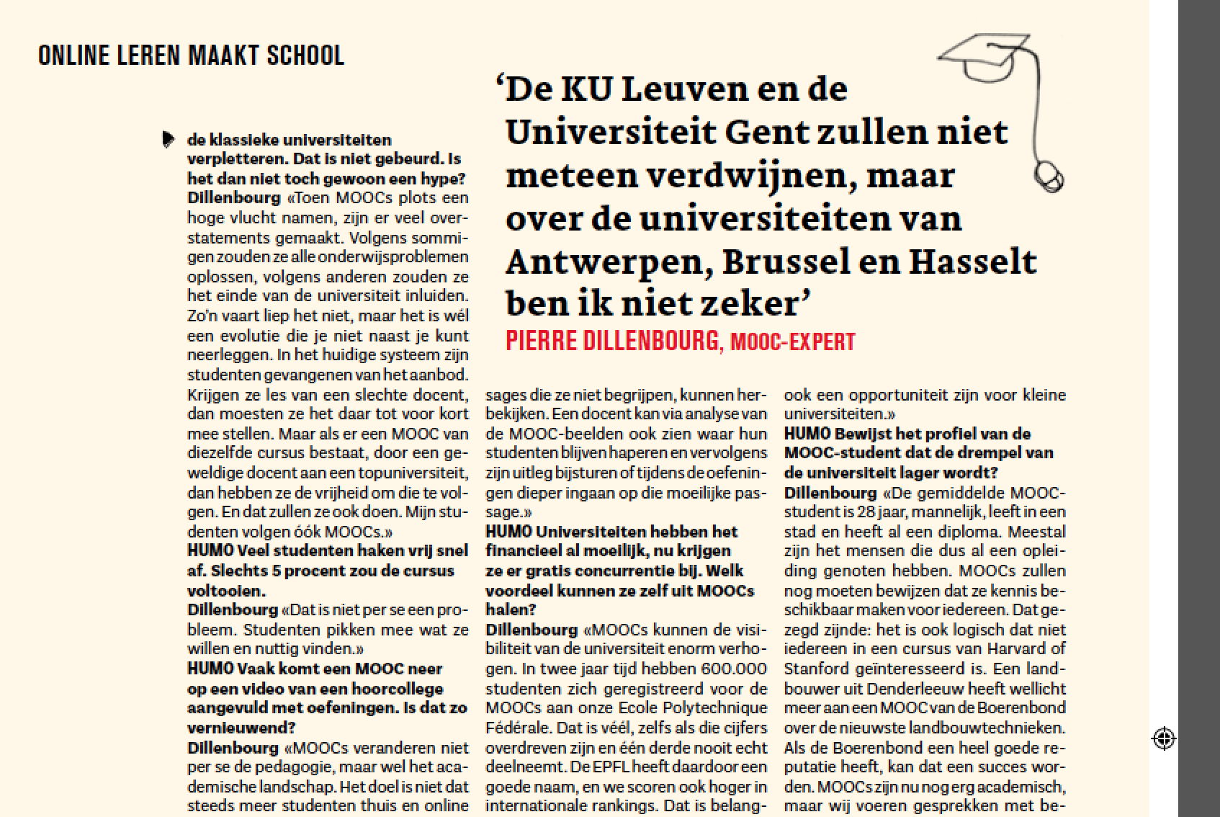
Will small universities disappear ?
HUMO

